Slide 1


Natural language processing to capture person-first or identity-first language
MethodsCon 2022
13-14 2022
Manchester, UK
Copyright © 2022 University of Manchester. Created by Cathie Marsh Institute, UK Data Service.
Notes:
Photo by 🇸🇮 Janko Ferlič on Unsplash

Slide 2
Who we are:
Professor Ramona Moldovan
University of Manchester, UK
Babeș-Bolyai University, Romania
Ramona.Moldovan@mft.nhs.uk
Dr. Julia Kasmire
Cathie Marsh Institute University of Manchester, UK
UK Data Service
J.Kasmire@manchester.ac.uk
@JKasmireComplex
Andrada Ciucă
Babeș-Bolyai University, Romania
andradaciuca@psychology.ro
Notes:
Clearly, there is a problem with 2004.

Slide 3
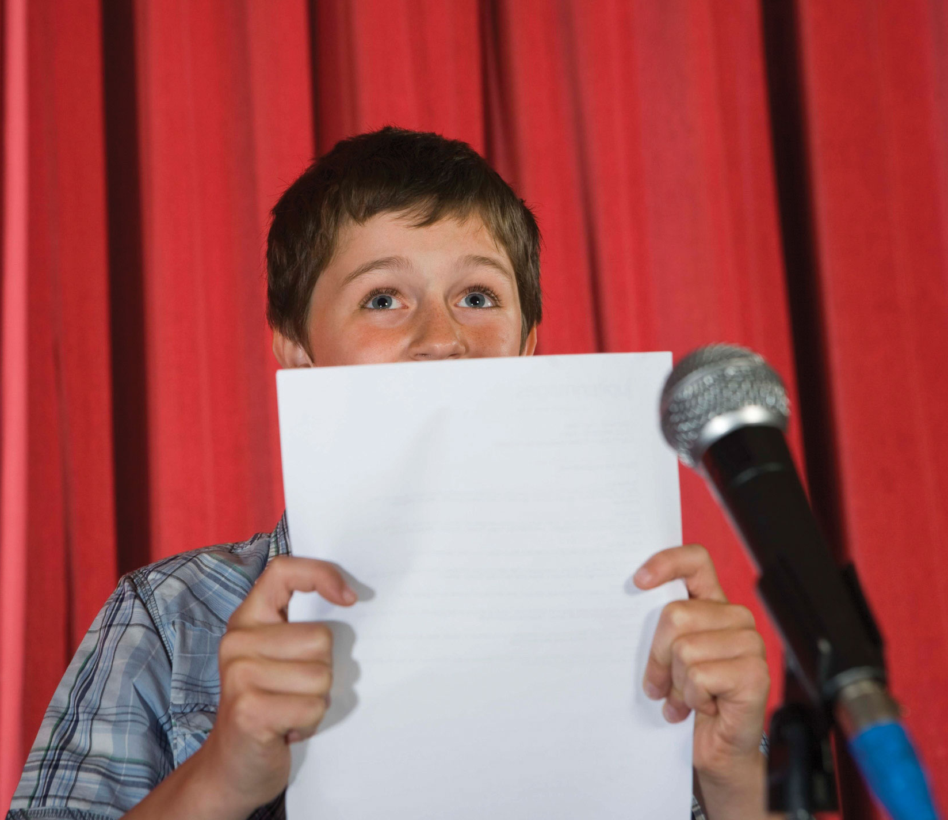
What’s the big idea?
Assuming that words matter, we wanted to know:
This Photo by Unknown Author is licensed under CC BY-SA-NC
Notes:
Clearly, there is a problem with 2004.

Slide 4
What’s the big idea?
Assuming that words matter, we wanted to know:
what language do people use?
what language are people recommended to use?
This Photo by Unknown Author is licensed under CC BY-SA-NC
Notes:
Clearly, there is a problem with 2004.

Slide 5
Person-first language
Notes:
Clearly, there is a problem with 2004.

Slide 6
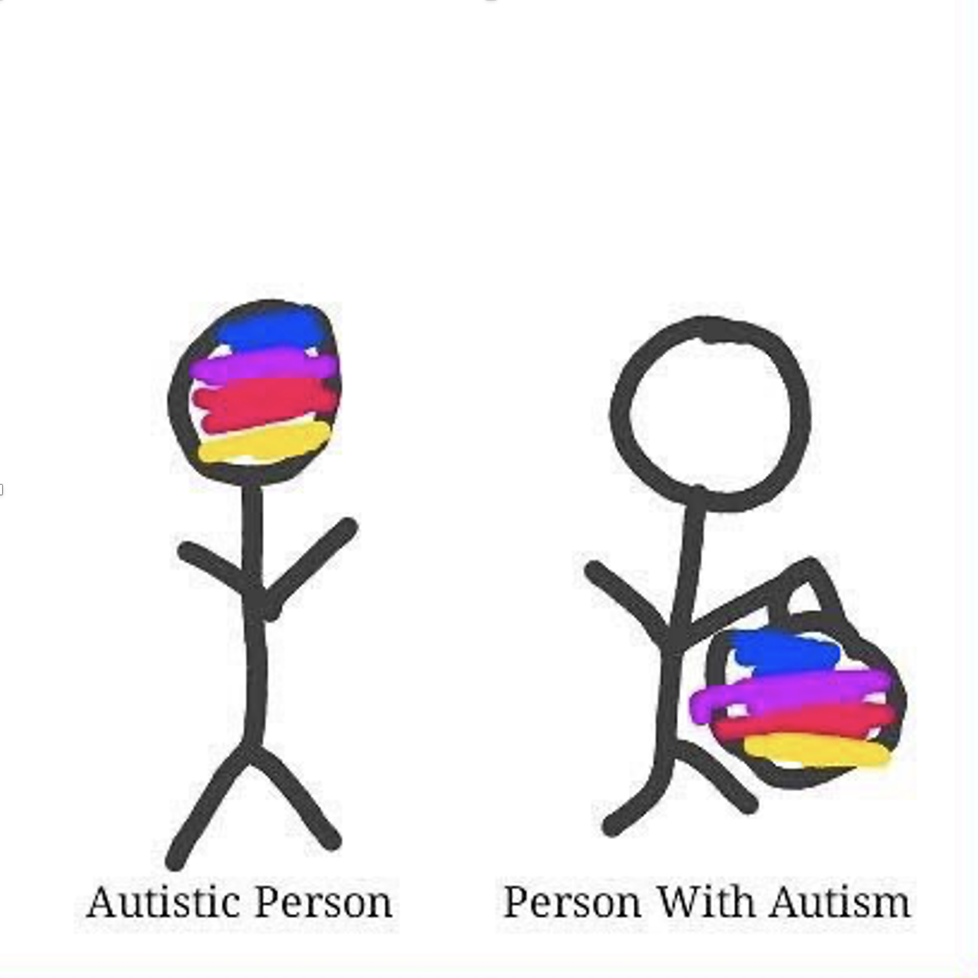
Person-first language
Person-first – “person with autism”, “child with hearing difficulties”, etc.
intends to highlight personhood before diagnosis
meant to avoid dehumanisation, marginalisation, or essentialisation
describes what a person “has” rather than what a person “is”
Notes:
Clearly, there is a problem with 2004.

Slide 7
Identity-first language
Notes:
Clearly, there is a problem with 2004.

Slide 8
Identity-first language
Identity-first - “an autistic person”, “a Deaf child”, etc.
some people see these terms as part of their identity/community
doesn’t separate person from adjective or suggest people are “same” with …
social model of disability suggests people “are” disabled by society
Notes:
Clearly, there is a problem with 2004.

Slide 9
Do you typically use person or identity first language?

Slide 10

Why does it matter?
Good guidance depends on many things, including:
What language the relevant people actually prefer?
What language people are actually using?
What existing guidance says and what impact it has?
This Photo by Unknown Author is licensed under CC BY-NC-ND
Notes:
Clearly, there is a problem with 2004.

Slide 11
Why does it matter?
Good guidance depends on many things, including:
What language the relevant people actually prefer?
What language people are actually using?
What existing guidance says and what impact it has?
This Photo by Unknown Author is licensed under CC BY-NC-ND
Notes:
Clearly, there is a problem with 2004.

Slide 12
Data = ESHG abstracts
173,955 abstracts from the European Society of Human Genetics Conferences
Year | Abstracts
2001 | 7805
2002 | 5517
2003 | 4539
2004 | 6619
2005 | 7289
2006 | 6026
2007 | 7283
2008 | 9794
Year | Abstracts
2009 | 7981
2010 | 7795
2011 | 9133
2011 | 9133
2012 | 8777
2013 | 10626
2014 | 9041
Year | Abstracts
2015 | 7978
2016 | 10734
2017 | 10405
2018 | 10429
2019 | 8250
2020 | 9590
2021 | 8344
Notes:
Clearly, there is a problem with 2004.

Slide 13
Focus on abstracts of interest
1721 abstracts with the keywords “autism”, “autistic”, “ASD” or “asperger”
Year | Total | Select
2001 | 7805 | 21
2002 | 5517 | 33
2003 | 4539 | 19
2004 | 6619 | 27
2005 | 7289 | 32
2006 | 6026 | 35
2007 | 7283 | 41
Year | Total | Select
2008 | 9794 | 72
2009 | 7981 | 42
2010 | 7795 | 74
2011 | 9133 | 104
2012 | 8777 | 108
2013 | 10626 | 137
2014 | 9041 | 116
Year | Total | Select
2015 | 7978 | 129
2016 | 10734 | 132
2017 | 10405 | 112
2018 | 10429 | 148
2019 | 8250 | 132
2020 | 9590 | 125
2021 | 8344 | 82
Notes:
Clearly, there is a problem with 2004.

Slide 14
Preparation
31 .pdf files
Acquire original files
Convert .pdf to .txt
All text from .pdf into one line
NLP
Frequency counts
Remove irrelevant pages (cover page, adverts, index, etc.)
Split line by abstract marker
Subset abstracts with keywords 173,995 abstracts -> 1721 abstracts
Examine contexts
Notes:
31 .pdf (some years have 2 files, e.g. one for presentation abstracts and one for poster abstracts)
Semi-manual process to remove irrelevant pages (e.g. remove the indices, cover pages, etc.)
Convert .pdf to .txt files
Split .txt file into abstracts by delimiters 167336
Find all abstracts that contain keywords 1694

Slide 15
How much do you know about NLP methods?

Slide 16
NLP Frequency Counts - “bag of words”
Prep
Tokenise words
Lowercase
Remove punctuation
Remove whitespaces
Remove stop words
Consolidate
* Correct spelling
* Substitute synonyms
Stem words
Analyse
Count word frequency
* Not used in the preliminary process

Slide 17
Stemming
A simplistic method of reducing words to a basic form
Collapses nouns and verbs together, as well as singular/plural, first/second/third person, future/present/past tenses, etc.
Examples:
Dog, dogs, and dogged would all reduce to “dog”
Went, going, goes and go would all reduce to “go”

Slide 18
Most common words in selected abstracts
Word | Freq | Word | Freq | Word | Freq | Word | Freq
‘patient' | 3698 | ‘autism' | 2101 | ‘delet' | 1564 | 'analysi' | 1187
'gene' | 3593 | ‘mutat' | 1915 | 'variant' | 1443 | 'result' | 1181
‘none' | 3532 | 'asd' | 1744 | 'chromosom' | 1439 | 'report' | 1170
‘genet' | 3161 | 'clinic' | 1742 | 'hospit' | 1278 | 'unit' | 1136
'de' | 2462 | 'syndrom' | 1620 | 'phenotyp' | 1254 | ‘famili' | 1123
'univers' | 2235 | 'studi' | 1601 | 'medic' | 1251 | 'genom' | 1040
'disord' | 2233 | ‘associ' | 1569 | 'use' | 1249 | 'spectrum' | 974
* Some results deleted for clarity

Slide 19
Keyword frequency
Word | Freq
‘autism' | 2101
'asd' | 1744
‘autist' | 549
‘asperger' | 56
* Some results deleted for clarity

Slide 20
NLP Examine Context - “pattern extraction”
Prep
Tokenise sentences
* Lowercase
* Remove punctuation
* Remove whitespaces
Consolidate
* Correct spelling
* Substitute synonyms
Isolate relevant sentences
Analyse
Extract person-first and identity-first patterns
Count each pattern
Examine each pattern
POS-tag
* Not used in the preliminary process
Notes:
153653 relevant sentences

Slide 21
“Noun with” / person-first pattern
pattern = [{"POS": "NOUN"},
{“LOWER": “with"}
{'DEP':'amod', 'OP':"?"},
{'DEP':'amod', 'OP':"?"},
{'DEP':'amod', 'OP':"?"},
{"TEXT": {"REGEX": “[Au]utism“ or “[Aa]sperger” or “ASD”}}]

Slide 22
“Noun with”/person-first examples, counts
Person with autism
Child with very small shoes
Households with environmentally responsible insulation
This dataset produced:
358 results
78 results after duplicates removed

Slide 23
Noun with ASD/Asperger/autism
adolescents with asd
allele with autism
association with asd/autism
boy(s) with (ideopathic) asd/autism
brother(s) with asd/autism
cases with autism
child(ren) with (ideopathic/simplex/syndromic)
asd/autism
cohort with autism
cousin with asd/asperger
deletion with autism
disability with asd
disorder with autism
duals with asd/autism
efficiency with autism
epilepsy with orwithout autism
families with asd/autism
female with autism
genes with autism
girl with (severe) autism
individual(s) with (syndromic) asd/autism
inositol with autism
male with autism
overlap with autism
pathway with autism
patient(s) with (ideopathic/regressive/syndromic/non- syndromic/isolated) asd/asperger/autism
people with asd/autism
proband(s) with asd
risk with autism
siblings with asd/autism
subject(s) with asd/autism
syndrome with autism
testing with diagnosed asd
trios with asd
twins with autism

Slide 24
Focus on people with ASD/Asperger/autism
adolescents with asd
allele with autism
association with asd/autism
boy(s) with (ideopathic) asd/autism
brother(s) with asd/autism
cases with autism
child(ren) with (ideopathic/simplex/syndromic)
asd/autism
cohort with autism
cousin with asd/asperger
deletion with autism
disability with asd
disorder with autism
duals with asd/autism
efficiency with autism
epilepsy with or without autism
families with asd/autism
female with autism
genes with autism
girl with (severe) autism
individual(s) with (syndromic) asd/autism
inositol with autism
male with autism
overlap with autism
pathway with autism
patient(s) with (ideopathic/regressive/syndromic/non- syndromic/isolated) asd/asperger/autism
people with asd/autism
proband(s) with asd
risk with autism
siblings with asd/autism
subject(s) with asd/autism
syndrome with autism
testing with diagnosed asd
trios with asd
twins with autism

Slide 25
“Adjective noun” / identity-first pattern
pattern = [{"TEXT": {"REGEX": “[Au]utistic“ or “[Aa]sperger” or “ASD”}},
{'DEP':'amod', 'OP':"?"},
{'DEP':'amod', 'OP':"?"},
{'DEP':'amod', 'OP':"?"},
{"POS": "NOUN"}]

Slide 26
“Adjective noun”/identity-first examples, counts
These autistic people
Extremely well shod people
A surprisingly energy-efficient household
This dataset produced:
840 results
144 results after duplicates removed

Slide 27
ASD/Asperger/autistic Noun
asperger autism
(related) gene(s)
autosomal dominant disorder
basque sample
behavior(s)
boy/girl
brain(s)
brother
candidate
case(s)
causing
cggs
child(ren)
cohort(s)
communication
comorbidity
conditions
dataset(s)
diagnosis
disease
disorder(s)
disturbed function
ethnic populations
etiology
families
features
forms
functional studies
genetic variants
genetics
germline
group(s)
heritability
heterogeneity
higher load
image
individual(s) results
inheritance
introduction
male
microcephaly
multigenic panel
multiplex
ostium
panel(s)
passivity
pathogenesis
pathology
patient(s)
patients
pheno pathways
phenotype(s)
population(s)
presentations
probands
pulmonary
quartets
regression
results
risk
sample(s)
secundum
sleep
small genomic deletions
sons
spectral disorders / spectrum
strategy
subject(s)
susceptibility
symptom(s)
syndrome(s)
technique
theadrenal cortex
trait(s)
unrelated patients
valve
variants
variome

Slide 28
Focus on people in ASD/Asperger/autistic Noun
asperger autism
(related) gene(s)
autosomal dominant disorder
basque sample
behavior(s)
boy/girl
brain(s)
brother
candidate
case(s)
causing
cggs
child(ren)
cohort(s)
communication
comorbidity
conditions
dataset(s)
diagnosis
disease
disorder(s)
disturbed function
(ethnic) population(s)
etiology
families
features
forms
functional studies
genetic variants
genetics
germline
group(s)
heritability
heterogeneity
higher load
image
individual(s)
inheritance
introduction
male
microcephaly
multigenic panel
multiplex
ostium
panel(s)
passivity
pathogenesis
pathology
(unrelated) patient(s)
pheno pathways
phenotype(s)
presentations
probands
pulmonary
quartets
regression
results
risk
sample(s)
secundum
sleep
small genomic deletions
sons
spectral disorders / spectrum
strategy
subject(s)
susceptibility
symptom(s)
syndrome(s)
technique
theadrenal cortex
trait(s)
valve
variants
variome

Slide 29
Why might factor into it?
Do we see differences based on:
- native language
- age of person described
- year
- use of adjectives in non-people related contexts
- other?
Notes:
Clearly, there is a problem with 2004.

Slide 30
What do you think influences whether someone uses PF or IF language?

Slide 31
What topics would you want NLP applied to?

Slide 32
Feel free to ask us questions!

Slide 33
Thank you.
https://github.com/UKDataServiceOpen/Person_Identy_First_Language.git

